Slide 1
PA USTIF
Competitive Bidding Research Update
Kaleb Javier
(https://www.kalebkjavier.com/)
UC Berkeley
January 16, 2026

Slide 2
Today
Current Analysis Results
  Claim Denials
  Closed Claims (Costs and Durations)
  Describe the state of Competitive Bidding
    How does a claim end up in a Competitive Bidding contract?
Highlight Extensions
  What are the gains from improving the Claims ➔ Auction system?

Slide 3
What is the Unit of Analysis?
Facility-Claims
A facility-claim is built from
  PA DEPs UST Public and Private UST databases (Thank you Josh Blanco!)
    All Tank component for all facilities in PA
  USTIF Claims (contracts and claims) datasets
  eFacts Violations database
A facility claims portfolio is built from all UST info at a site on or before report_date in the claims data.
Notes:
No efacts at this time. Data was challenging to turn into usable variables. Future analysis can bring in violation history and penalties that current does not.

Slide 4
Comparing Risk Detection Methods
UST Data is rich in facility descriptions ~380 variables that describe a facility at report date.
I approached this analysis using two sets of information:
Approach 1: Standard Indicators. Based on established institutional knowledge (e.g., bare steel, tank age).
Approach 2: Machine Learning (ML) Data-Driven Discovery. Using algorithms to identify non-obvious patterns across all ~380 facility variables.
* ML only feasible on full claims data

Slide 5
Drivers of Claim Denial

Slide 6
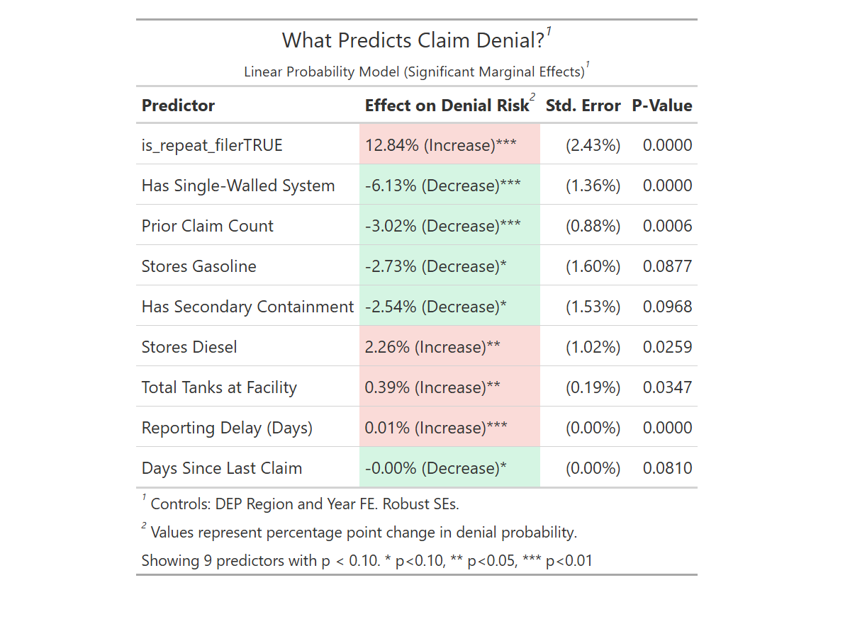
Notes:
Visual Orientation: "This table shows us the 'risk factors' that make a claim likely to be denied. The percentages show how much that specific factor increases or decreases the probability of denial."
The Takeaway: Human behavior (filing history) is a stronger predictor of denial than the physical state of the tank.
Talking Points:
Repeat Filer (+12.8%): If a facility has filed claims before, they are significantly more likely to be denied this time. This is our strongest signal.
Reporting Delay: For every day a facility waits to report a leak, the chance of denial creeps up.
The Counter-Intuitive Finding: You might see that Single-Walled Systems (usually risky) are less likely to be denied. This likely means adjusters scrutinize these sites heavily upfront, or owners of these tanks are hyper-aware of compliance needs.

Slide 7
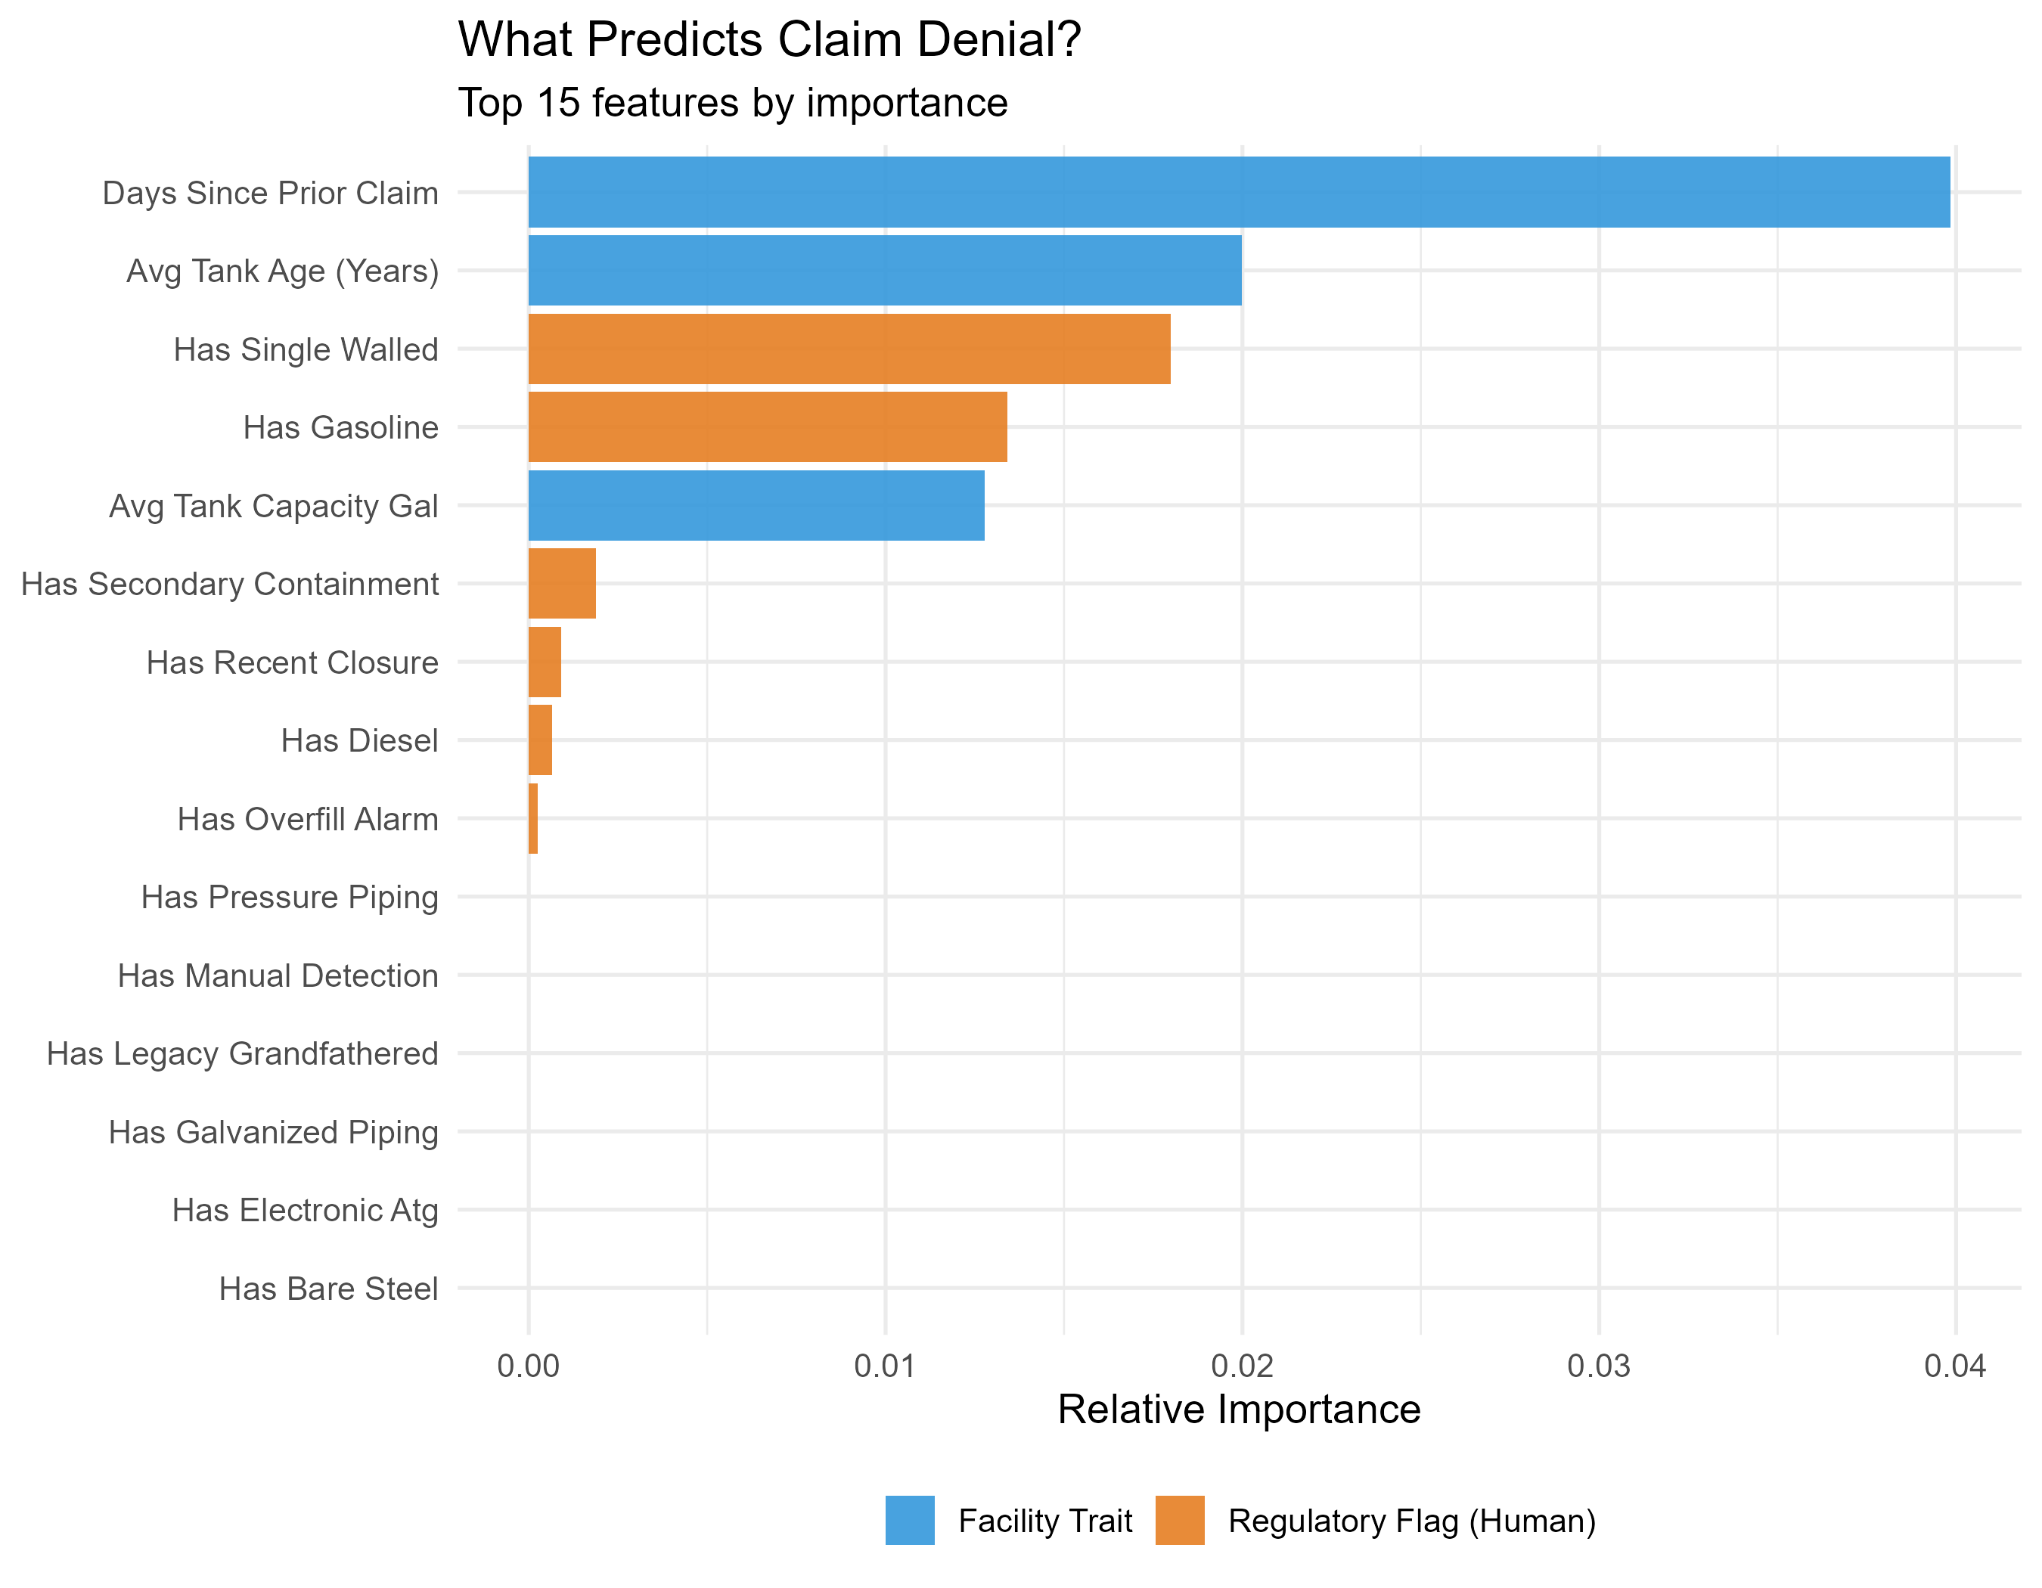
Notes:
Feature Importance (Bar Chart)
Visual Orientation: "We asked a Machine Learning model to look at every variable we have and rank them by how useful they are in predicting denial. The longer the bar, the more 'information' that variable holds."
The Takeaway: History repeats itself. The strongest signals are behavioral, not physical.
Talking Points:
The top bar is Days Since Prior Claim. This confirms that the facility's history with the fund is the single best way to predict if a current claim is valid.
Physical traits like Tank Age and Single-Walled status matter, but they are secondary to the facility's operational history.

Slide 8
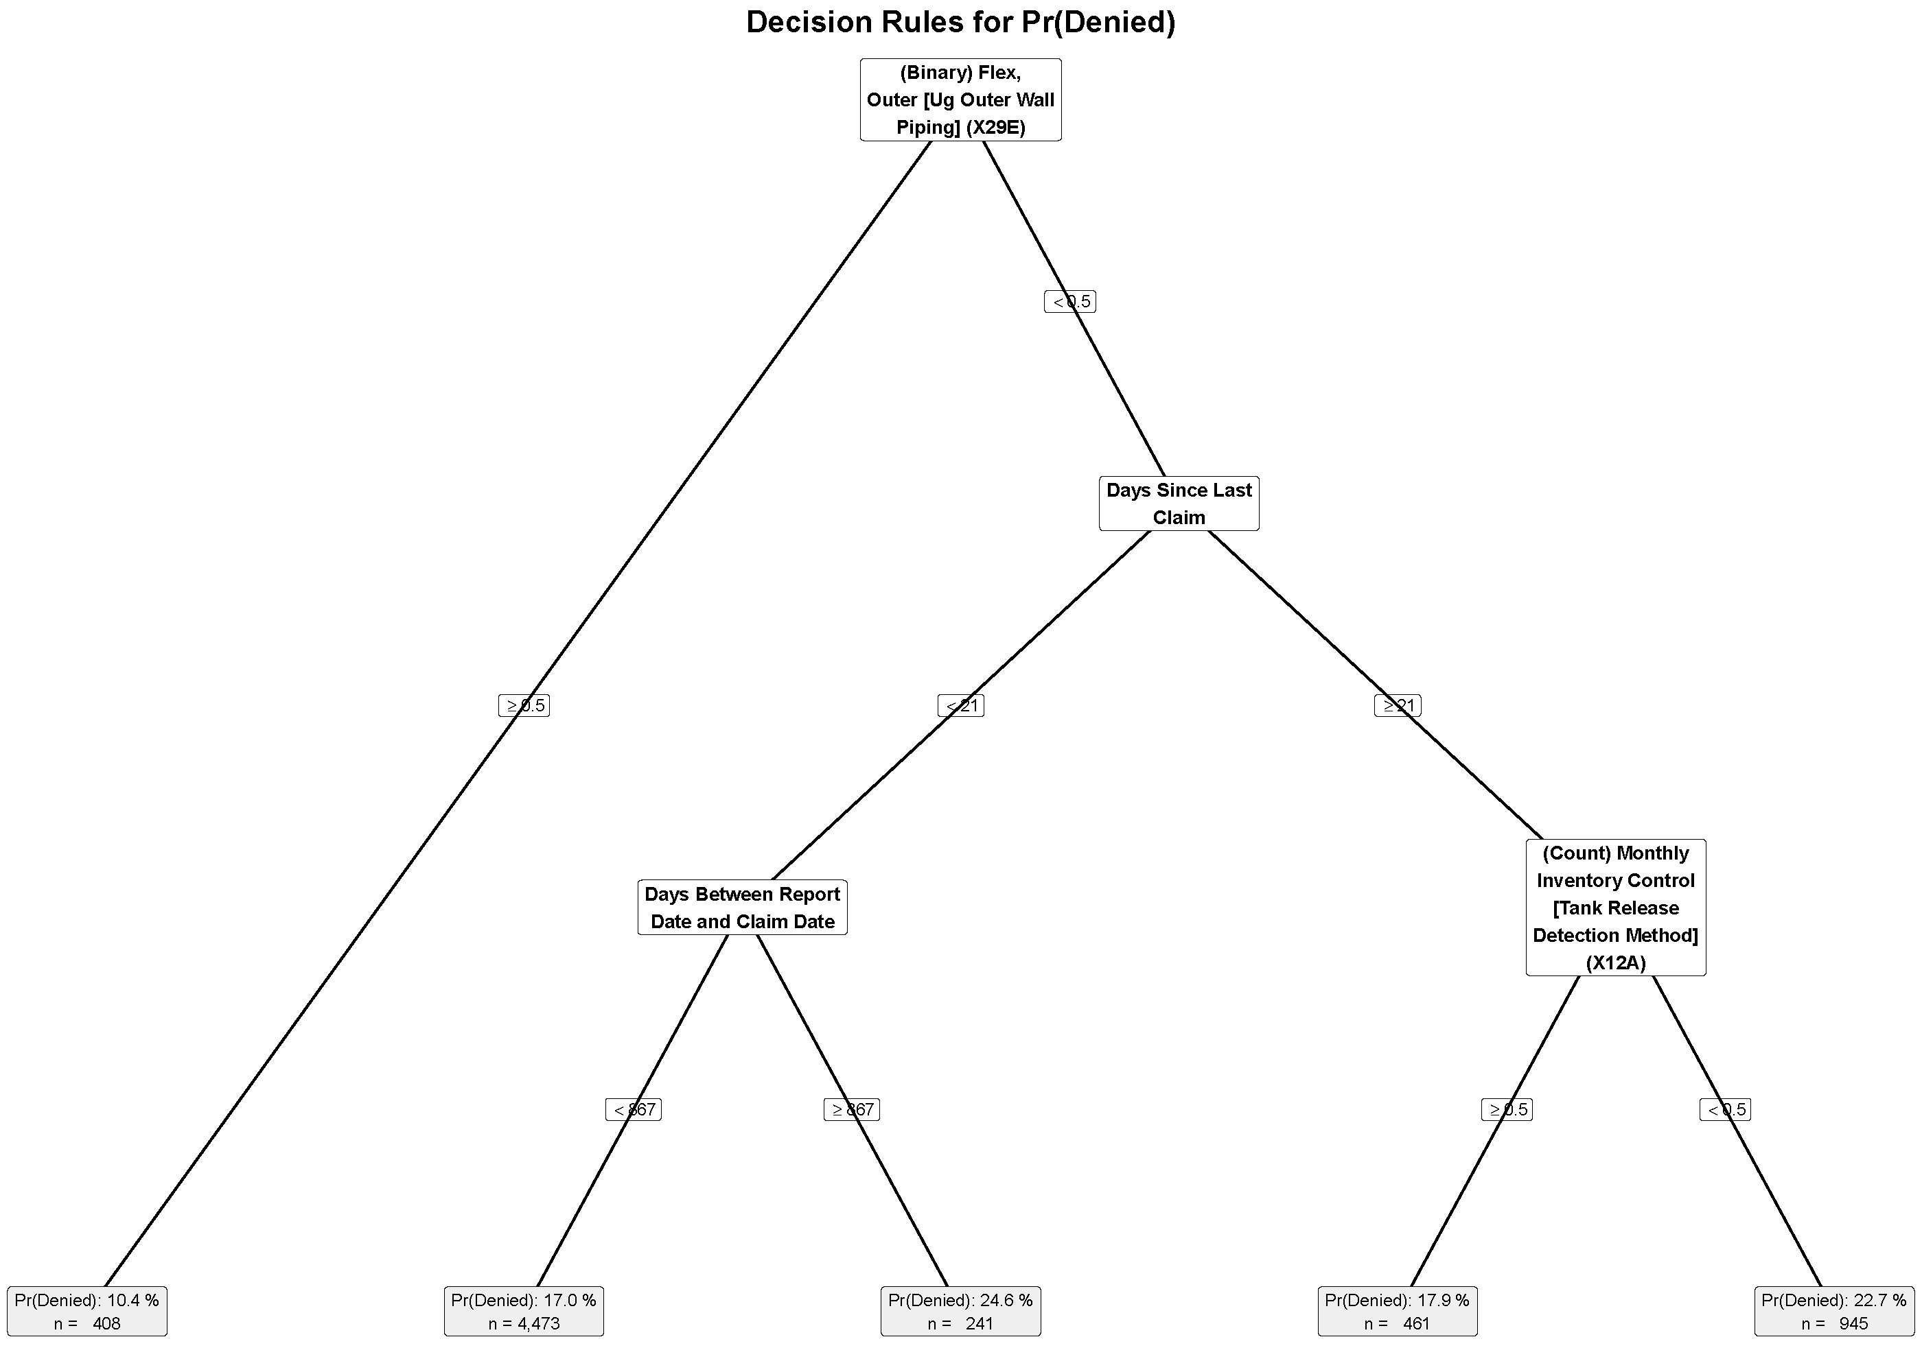
Notes:
Decision Tree (Flowchart)
Visual Orientation: "This is a 'Decision Tree.' It simulates the logic flow of sorting claims. Read it from top to bottom."
The Takeaway: We can segment claims into high-risk and low-risk buckets using just 2-3 questions.
Talking Points:
The Left Path: If the piping is Flexible (safer) and the claim is reported quickly (< 267 days), the denial rate drops to 10.4%. These are our "safe" claims.
The Right Path: If it takes a long time to report, and they haven't had a claim recently, the denial rate jumps to nearly 23%.
Utility: We can use this logic to "fast track" the left bucket and audit the right bucket.

Slide 9
Drivers of Claim Cost

Slide 10
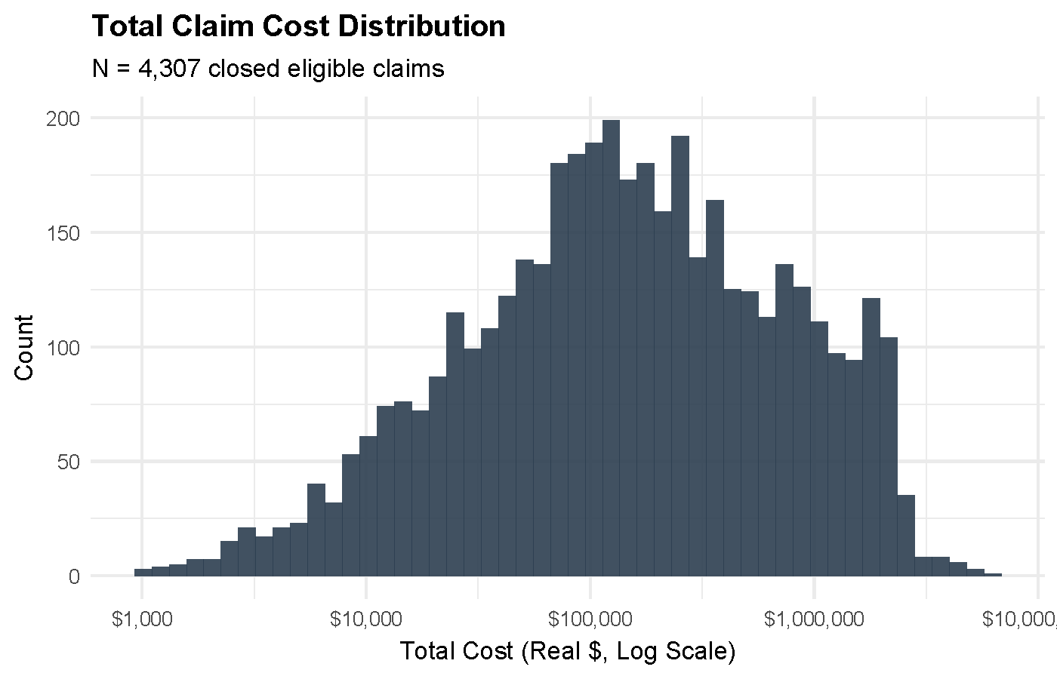
Notes:
Slide 10: Total Claim Cost Distribution (Histogram)
Visual Orientation: "This chart shows how expensive claims are. The scale along the bottom is logarithmic—meaning each step represents a 10x increase in cost."
The Takeaway: We are dealing with a "Long Tail" risk profile.
Talking Points:
Most claims cluster around the $100,000 to $200,000 range.
However, look at the tail on the right. We have a significant number of claims pushing past $1 million.
From a fund management perspective, predicting and managing these "outlier" events is more important than managing the average claim.

Slide 11
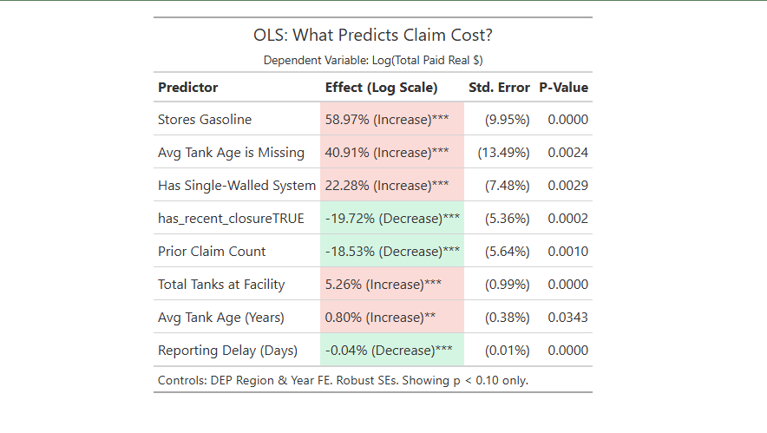
Notes:
Predictors of Cost Increases
Stores Gasoline: The presence of gasoline storage is associated with a 58.97% increase in total claim cost compared to the baseline (p<0.0001).
Avg Tank Age is Missing: The absence of tank age data correlates with a 40.91% increase in claim cost (p=0.0024).
Has Single-Walled System: Facilities utilizing single-walled tank systems are associated with a 22.28% increase in claim cost (p=0.0029).
Total Tanks at Facility: A one-unit increase in the number of tanks is associated with a 5.26% increase in claim cost (p<0.0001).
Avg Tank Age (Years): Each additional year of average tank age is associated with a 0.80% increase in claim cost (p=0.0343).
Predictors of Cost Decreases
has_recent_closureTRUE: The presence of a tank closed within 90 days of the claim date is associated with a 19.72% decrease in claim cost (p=0.0002).
Prior Claim Count: An increase in the count of prior claims is associated with an 18.53% decrease in claim cost (p=0.0010).
Reporting Delay (Days): Each additional day of reporting delay is associated with a 0.04% decrease in claim cost (p<0.0001).

Slide 12
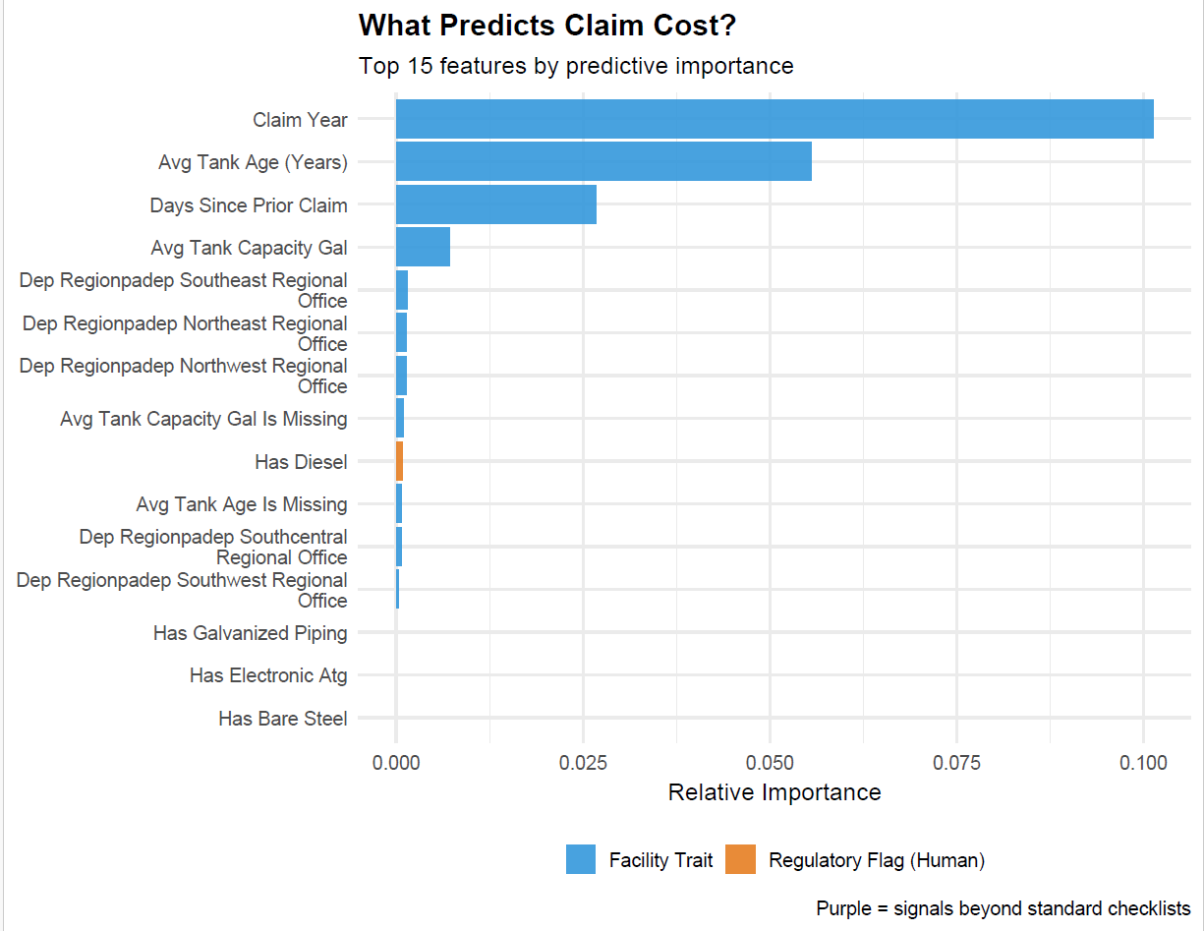
Notes:
Analysis and Target: The figure presents the results of a GRF analysis, showing the top 15 features by predictive importance for "Claim Cost".
Top Predictors: The most influential feature is "Claim Year," followed by "Avg Tank Age (Years)" and "Days Since Prior Claim". These three features have the highest relative importance among the top 15.
Feature Categories: The features are categorized as either a "Facility Trait" (blue bars) or a "Regulatory Flag (Human)" (orange bar).
Category Dominance: All of the top 15 features are classified as "Facility Trait" except for "Has Diesel," which is a "Regulatory Flag (Human)".
Low-Importance Features: Several features at the bottom of the list, such as "Has Galvanized Piping," "Has Electronic Atg," and "Has Bare Steel," show near-zero relative importance in this analysis.

Slide 13
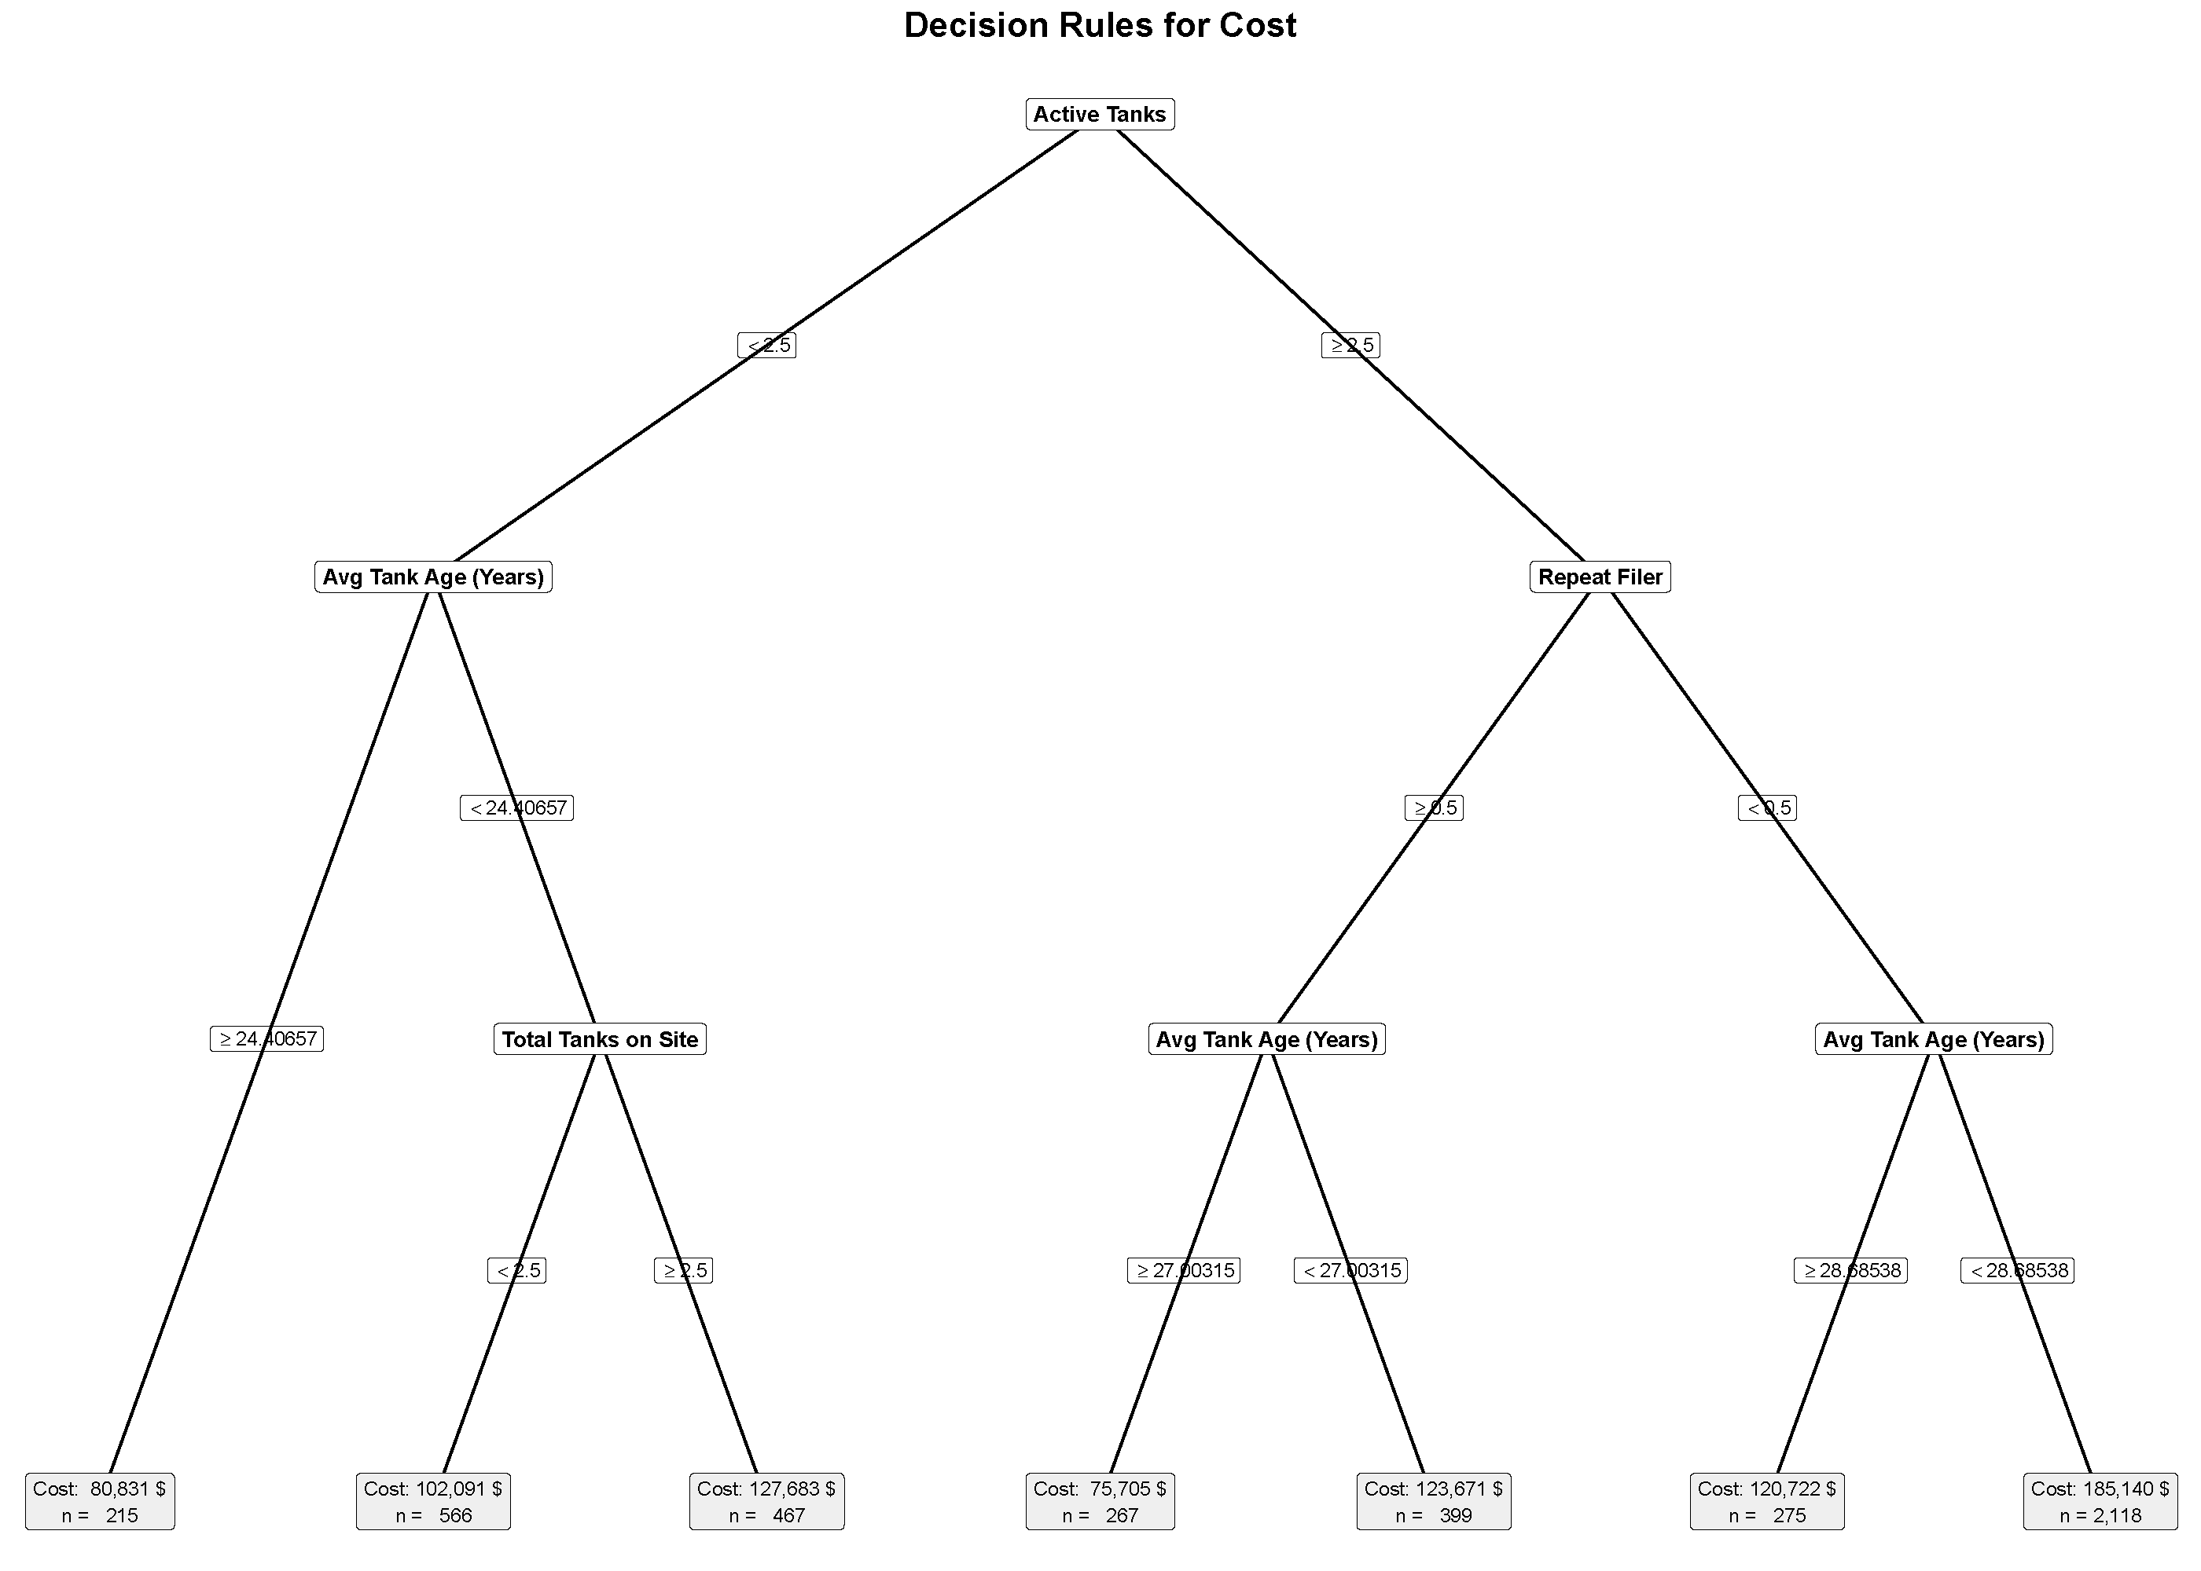
Notes:
Visual Orientation: "This tree breaks down claims into cost buckets based on facility characteristics. The dollar figures at the bottom represent the average cost for that group."
The Takeaway: Physical complexity (number of tanks) and age drive the price tag.
Talking Points:
The Low-Cost Path (Left): If a site has fewer active tanks and they are relatively new (under ~24 years), the average cost stays around $80,000.
The High-Cost Path (Right): Older tanks (>28 years) significantly increase the liability, pushing average costs up to $185,000.

Slide 14
Drivers of Claim Duration

Slide 15
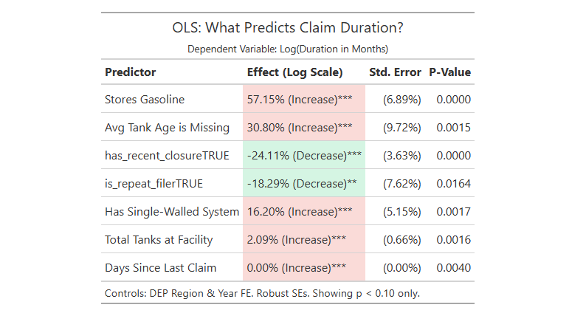
Notes:
Slide 15: What Predicts Claim Duration? (Regression Table)
Visual Orientation: "This table identifies which factors extend the timeline of a cleanup. A positive (red) percentage means the cleanup takes longer."
The Takeaway: Gasoline claims and missing data create delays; closures speed things up.
Talking Points:
Stores Gasoline (+57%): a facility that stores gas has longer claims ~ 57% longer then a non-gasoline facility.
Recent Closure (-24%): If the facility recently closed its tanks, the timeline shrinks.
Missing Data (+30%): Once again, "Avg Tank Age is Missing" is a proxy for uncertainty. If we don't know what's in the ground, it takes longer to fix.

Slide 16
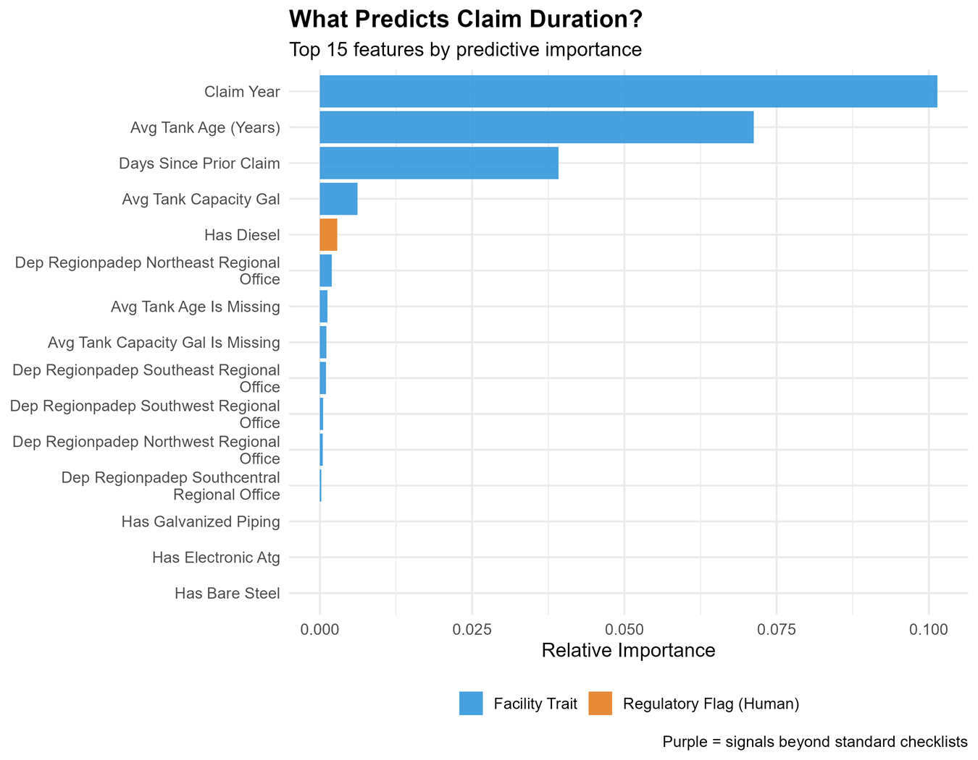
Notes:
Based on the provided figure from the GRF analysis, here is a note on the variable importance for predicting claim duration:
Analysis and Target: The figure displays the results of a GRF analysis identifying the top 15 features with the highest predictive importance for "Claim Duration."
Top Predictors: Similar to the cost model, the dominant predictors are "Claim Year," "Avg Tank Age (Years)," and "Days Since Prior Claim." These three variables consistently rank as the most critical drivers for predicting how long a claim remains open.
Feature Categories: The features are divided into "Facility Trait" (blue bars) and "Regulatory Flag (Human)" (orange bar).
Category Dominance: "Facility Traits" overwhelmingly dominate the top rankings. The only "Regulatory Flag (Human)" to appear in the top 15 is "Has Diesel," which ranks 5th—significantly higher here than in the claim cost analysis (where it ranked 9th).
Low-Importance Features: Infrastructure material variables such as "Has Galvanized Piping," "Has Electronic Atg," and "Has Bare Steel" appear at the bottom of the list with negligible predictive power relative to the temporal and age-based variables.

Slide 17
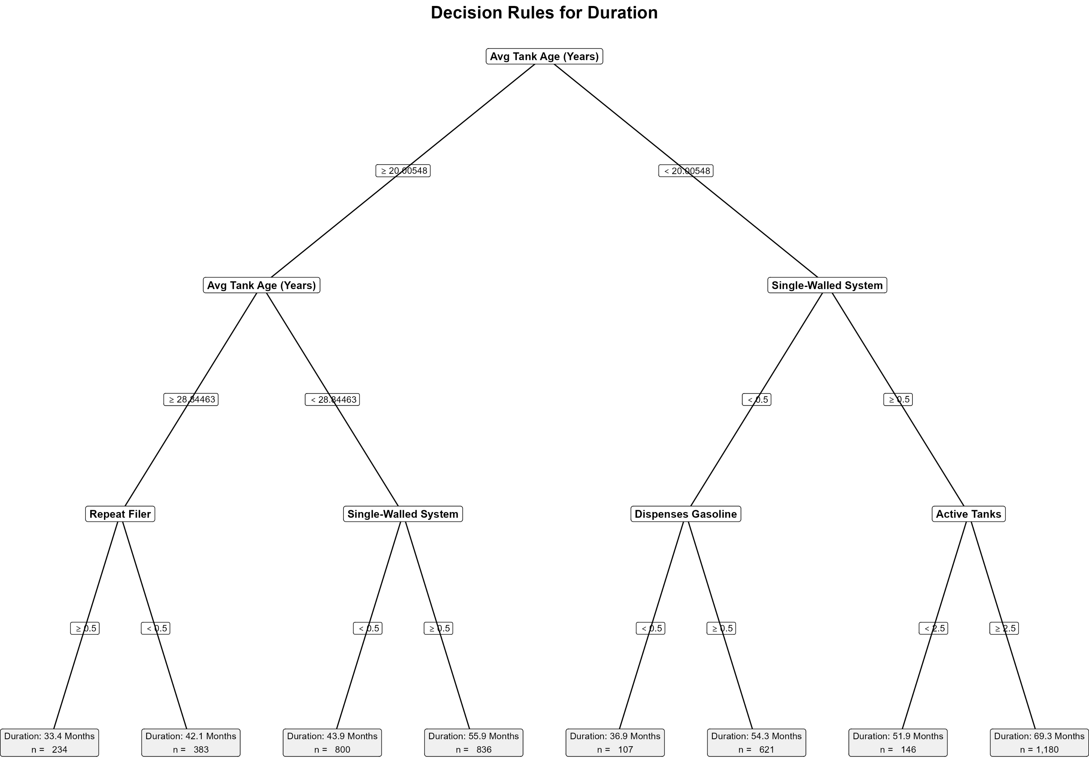
Notes:
Primary Segmentation (Age Thresholds)
Root Split: The primary determinant of claim duration is "Avg Tank Age," splitting the population at the 20-year mark.
Secondary Segmentation: For older tanks (≥ 20 years), the population is further bifurcated at 28.84 years, creating a distinct "legacy" cohort versus a "mid-age" cohort.
Branch Logic: The "Younger" Cohort (< 20 Years)
Infrastructure Penalty: In the younger cohort, the presence of a "Single-Walled System" (≥ 0.5) acts as a critical risk multiplier. The highest duration in the entire tree (69.3 months) occurs in this branch when combined with a high facility scale (Active Tanks ≥ 2.5).
Substance Risk: For younger tanks without single-walled systems (Double-Walled), dispensing gasoline increases the average duration from 36.9 months to 54.3 months, a 47% increase attributable solely to the substance type.
Branch Logic: The "Older" Cohort (≥ 20 Years)
The Experience Mitigation: Among the oldest tanks (≥ 28.84 years), "Repeat Filer" status acts as a strong mitigator. Repeat filers average 33.4 months per claim (the lowest duration in the tree), whereas non-repeat filers with similar legacy infrastructure average 42.1 months.
Mid-Age Vulnerability: For tanks aged 20–28.8 years, single-walled systems drive duration up to 55.9 months, compared to 43.9 months for double-walled systems in the same age bracket.
Extremes
Worst-Case Scenario: Young tanks (< 20 years) + Single-Walled + High Volume (Active Tanks ≥ 2.5) = 69.3 Months ($n=1,180$).
Best-Case Scenario: Oldest tanks (≥ 28.8 years) + Repeat Filer = 33.4 Months ($n=234$).

Slide 18
Contracts and Competitive Bidding

Slide 19
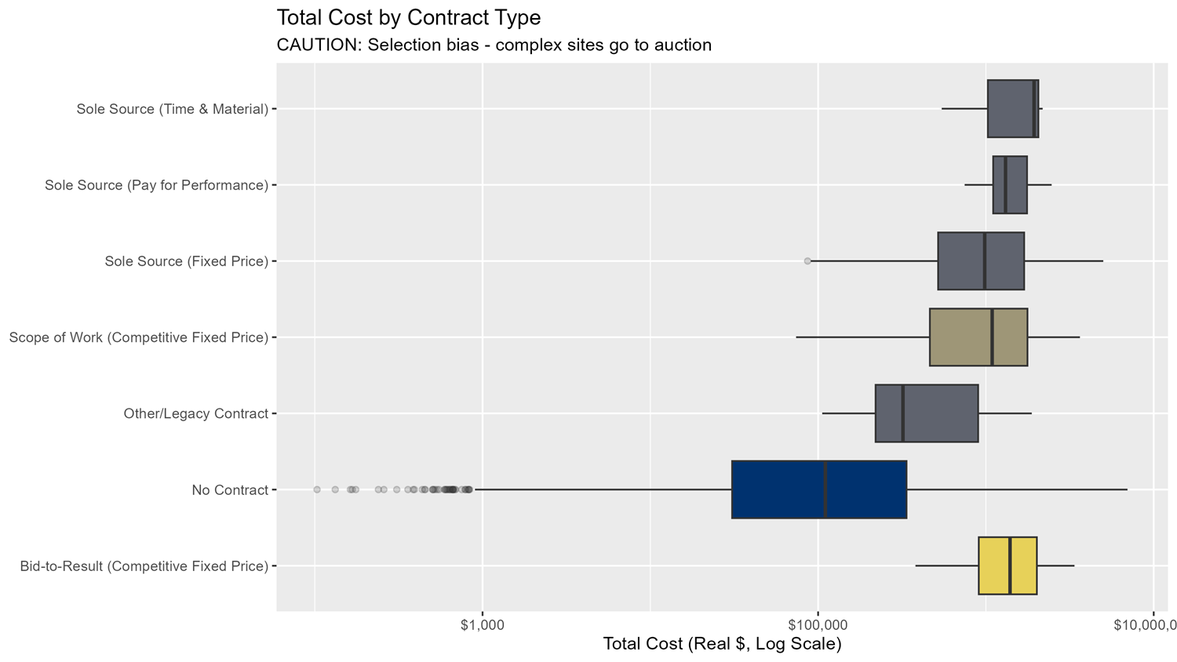
Notes:
Slide 19: Total Cost by Contract Type (Boxplots)
Visual Orientation: "Each box represents the range of costs for a different contract type. The line in the middle of the box is the median cost."
The Takeaway: Caution. Do not misinterpret this chart.
Talking Points:
It looks like Competitive Bidding (the green/yellow boxes) is more expensive than Sole Source (the top grey boxes).
Selection Bias: This is not because auctions are wasteful. It is because we only send the hardest, messiest, and most expensive sites to auction.
We are comparing "apples to oranges"—simple sites stay internal; complex sites go to auction.

Slide 20
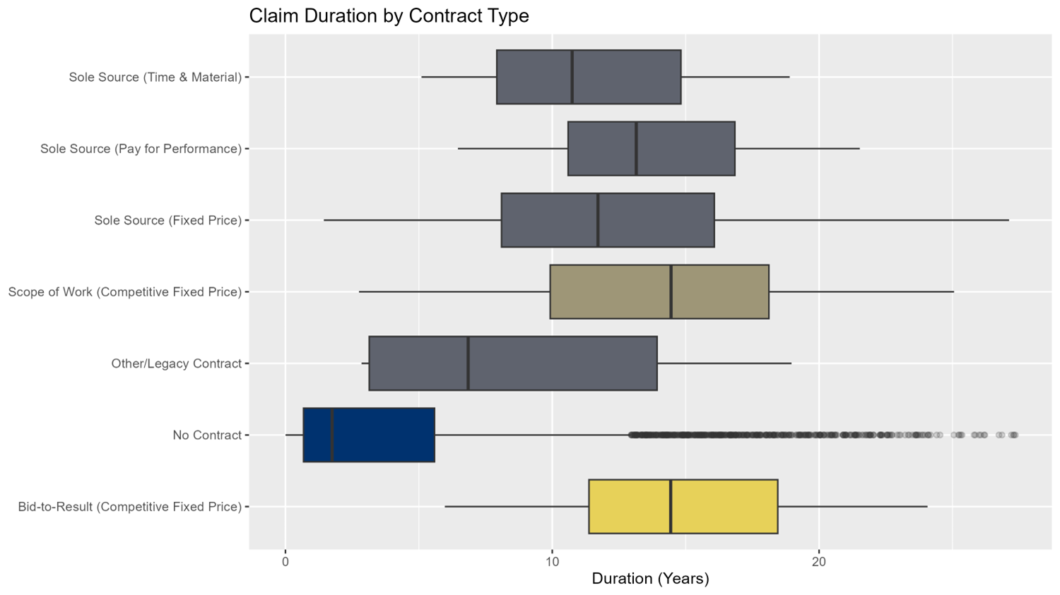
Notes:
Claim Duration by Contract Type (Boxplots) Visual Orientation: "Each box represents the range of claim durations for a different contract type. The line in the middle of the box is the median duration."
The Takeaway: Caution. Do not misinterpret this chart. The apparent longer duration for competitive contracts is likely a result of selection bias.
Talking Points:
It appears that Competitive Bidding contracts, such as "Scope of Work (Competitive Fixed Price)" and "Bid-to-Result (Competitive Fixed Price)" (the green and yellow boxes), have longer median durations than Sole Source contracts (the top grey boxes).
Selection Bias: This is not necessarily because the competitive bidding process is slower. It is likely because only the most complex and time-consuming projects are put out for a competitive bid.
We are comparing "apples to oranges"—simple projects with shorter expected durations are handled with sole source contracts, while complex projects with longer expected durations are sent to auction.
Claims with "No Contract" have the shortest median duration but also a long tail of outliers, indicating a high variability in their resolution times.

Slide 21
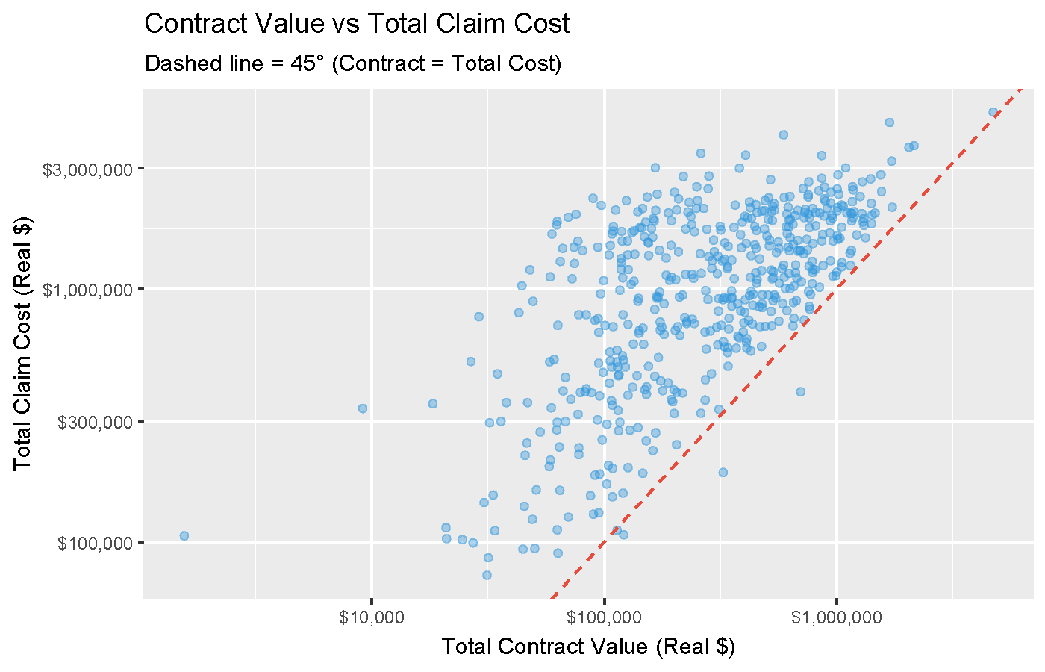
Notes:
Visual Orientation
The Axes: The X-axis represents the specific cost of the state's contract intervention ("Contract Value"), while the Y-axis represents the final "Total Claim Cost." Both axes use a logarithmic scale ($10k, $100k, $1M).
The Reference Line: The red dashed line marks the 45° parity point where Contract Value equals Total Claim Cost (a 1:1 ratio).
The Takeaway: The "Overhead Wedge"
Cost Composition: Virtually all data points lie significantly above the red dashed line. This confirms that the Contract Value is a subset of the Total Claim Cost, and never the totality. There is always a "wedge" of non-contract costs (likely administrative overhead, initial emergency response, or pre-contract assessments) that drives the total claim cost higher than the specific intervention contract.
Scale Variance (The "Share" Question):
High-Cost Claims (Right Side): As the Contract Value increases (moving right toward $1,000,000), the data points cluster tighter to the red parity line. This indicates that for massive cleanups, the contract intervention becomes the dominant share of the total cost (approaching 100%).
Low-Cost Claims (Left Side): For smaller contracts (below $100,000), there is high vertical dispersion. A contract of $10,000 might correspond to a total claim of $100,000+ (a 10x multiplier). This suggests that for smaller interventions, the contract is a minor share of the cost, overshadowed by fixed overheads or other spending categories.
Correlation
Predictive Power: There is a strong, positive linear correlation (in log-log space). While the contract is not the whole cost, it is a highly reliable predictor of the total cost magnitude. As the intervention scales, the total liability scales proportionally.

Slide 22
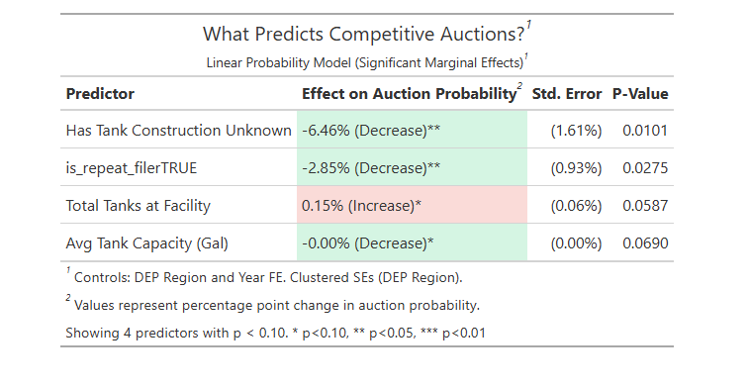
Notes:
Predictors of Decreased Auction Probability
Information Uncertainty: The most significant deterrent to competitive bidding is missing data. When "Tank Construction is Unknown," the probability of the claim going to auction drops by 6.46 percentage points ($p = 0.0101$). This suggests that regulators or contractors avoid fixed-price auctions when the underlying infrastructure risks are opaque.
Institutional Familiarity: Repeat filers are associated with a 2.85 percentage point decrease in auction probability ($p = 0.0275$). This indicates that established relationships or prior experience may streamline the process into non-competitive channels (e.g., sole sourcing) rather than public bidding.
Tank Capacity: While statistically significant at the 10% level ($p = 0.0690$), "Avg Tank Capacity" shows a coefficient of -0.00%, indicating no practical impact on the decision to auction despite the mathematical correlation.
Predictors of Increased Auction Probability
Facility Scale: There is a marginal positive association with facility size. For each additional tank at a facility, the probability of an auction increases by 0.15 percentage points ($p = 0.0587$). This suggests a slight tendency to send larger, more complex sites to competitive bid.
Model Constraints
Significance Thresholds: Unlike previous models where most variables were highly significant ($p < 0.001$), this model relies on weaker signals. "Total Tanks" and "Avg Tank Capacity" meet only the 10% confidence threshold ($p < 0.10$), making them less robust predictors than "Unknown Construction" or "Repeat Filer".

Slide 23
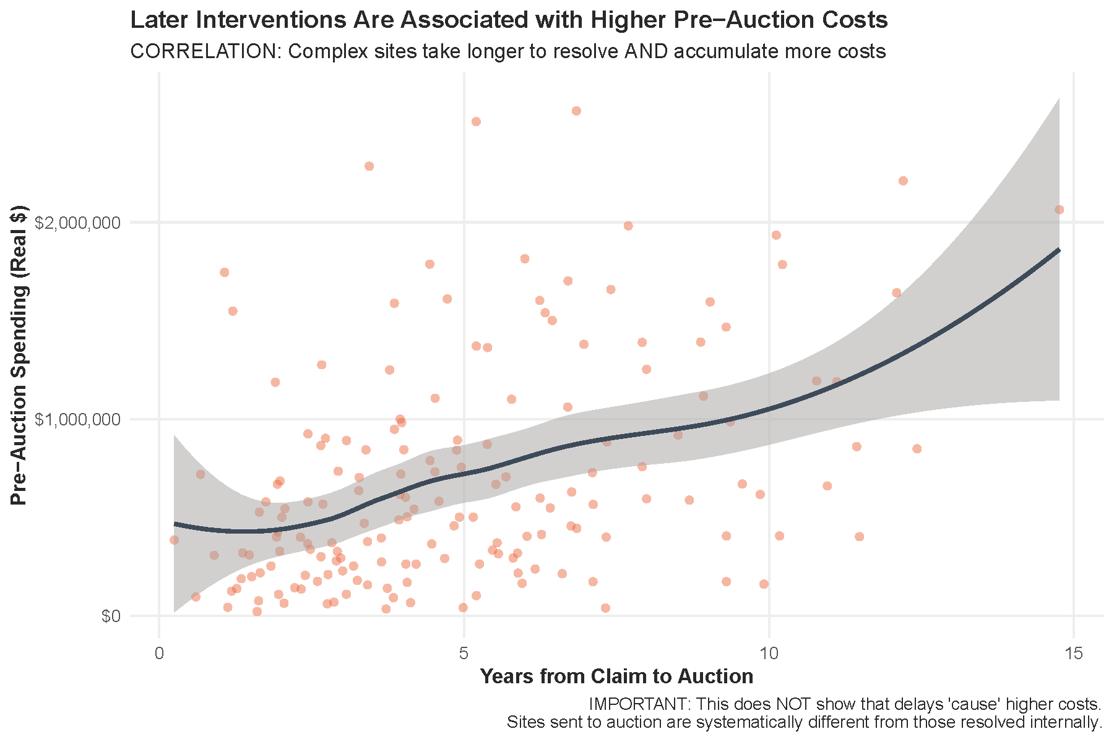
Notes:
Slide 23: Pre-Auction Spending vs. Time (Scatterplot)
Visual Orientation: "Each dot is a claim. The bottom axis is years until we held an auction. The vertical axis is money spent before the auction even started."
The Takeaway: Delay has a price tag.
Talking Points:
The line trends upward. The longer we wait to intervene, the more money we burn on "pre-auction" activities.
Claims sitting for 10+ years often accumulate $1 million+ in costs before we ever get a fixed-price contract in place.
While some investigation is necessary, this suggests we may be waiting too long on "zombie claims."

Slide 24
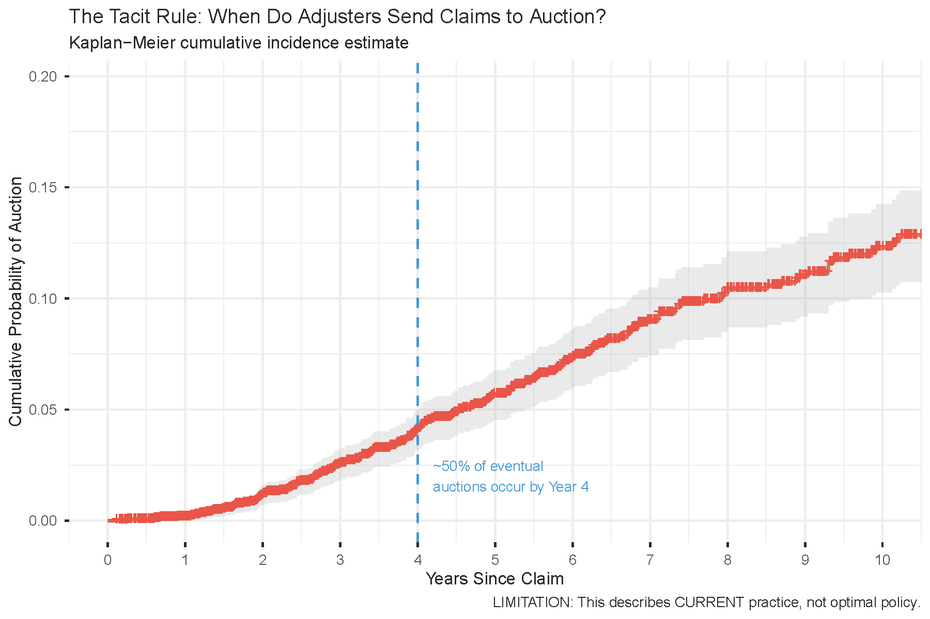
Notes:
Slide 24: The Tacit Rule (Kaplan-Meier Curve)
Visual Orientation: "This is a survival curve. It shows the probability of a claim going to auction over time."
The Takeaway: There is an unwritten "4-Year Rule."
Talking Points:
Look at the shape of the red line. It stays flat, then starts rising steeply around Year 4.
The Insight: Adjusters generally try to manage claims internally for about 4 years. If it's not fixed by then, they "give up" and send it to auction.
The Question: If we know at Year 1 that a claim is complex, why wait until Year 4? We are paying 3 years of holding costs just to reach the same conclusion.

Slide 25
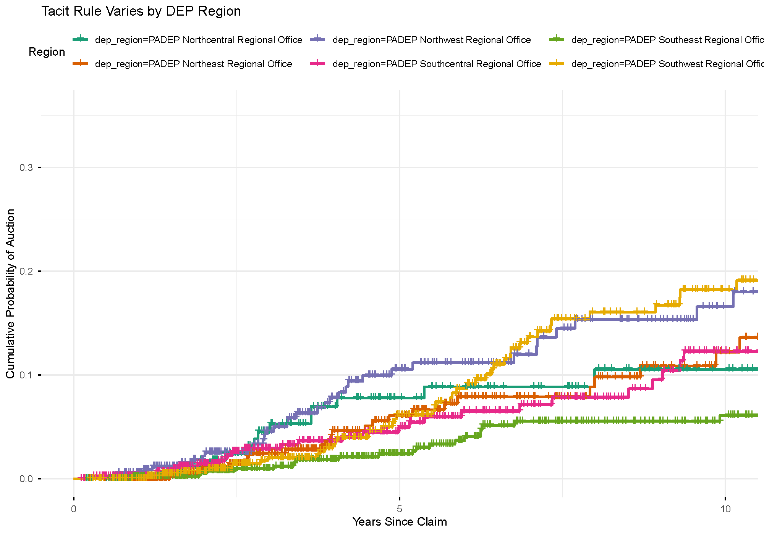
Notes:
Slide 25: Regional Variation (Regional Curves)
Visual Orientation: "This is the same 'Waiting Game' curve, but broken down by DEP Region."
The Takeaway: We lack a standardized statewide policy.
Talking Points:
The lines are not together. Some regions (yellow/purple lines) are aggressive—they send claims to auction quickly.
Other regions (green/red lines) wait much longer.
This inconsistency suggest region to region variation. Note this could be spurious, perhaps this picks up region specific challenge like rural vs city, soil, water access etc.

Slide 26
Auction Market Concentration

Slide 27
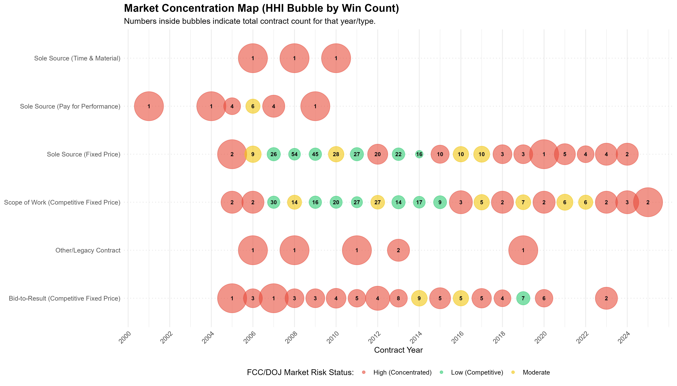
Notes:
Auction Market Concentration (The "Bubble" Chart) "This chart visualizes contract volume and market concentration from 2000 to the present.
The bubbles represent annual contract volume, and the red color coding indicates a high HHI score (high concentration).
However, we must interpret the 'red' status with caution. Many bubbles contain very low integers (e.g., 1–5 contracts) .
Because HHI is a mechanical calculation, scores automatically reflect 'high concentration' in years with low volume, regardless of actual competitive health.
The data suggests we are viewing a 'small numbers' problem rather than a pure market failure."

Slide 28
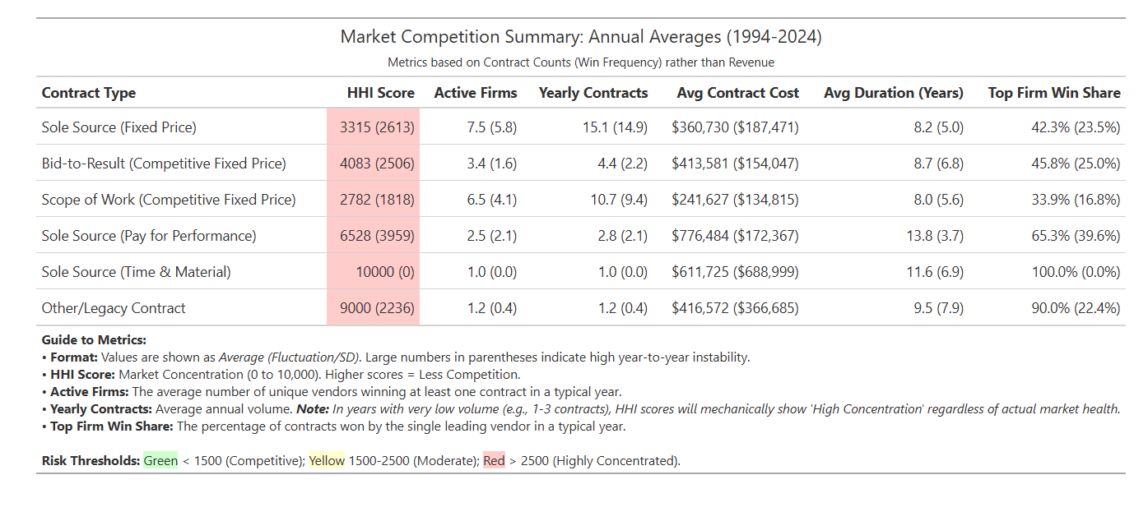
Notes:
This table averages competition metrics over the full 30-year period.
A key focal point is the 'Top Firm Win Share' column, which shows that for 'Bid-to-Result' contracts, the top firm in any given year captures 45.8% of the market on average.
It is critical to distinguish this metric from the 'Win Share' you will see on the next slide.
This table measures Annual Intensity: it calculates the market share of the winner in each specific year and averages those percentages.
It answers the question: 'In a typical year, how much of the pie does the winner take?' If Firm A wins 100% of contracts in 2010 and Firm B wins 100% in 2011, this metric would report 100%, capturing short-term monopolization

Slide 29
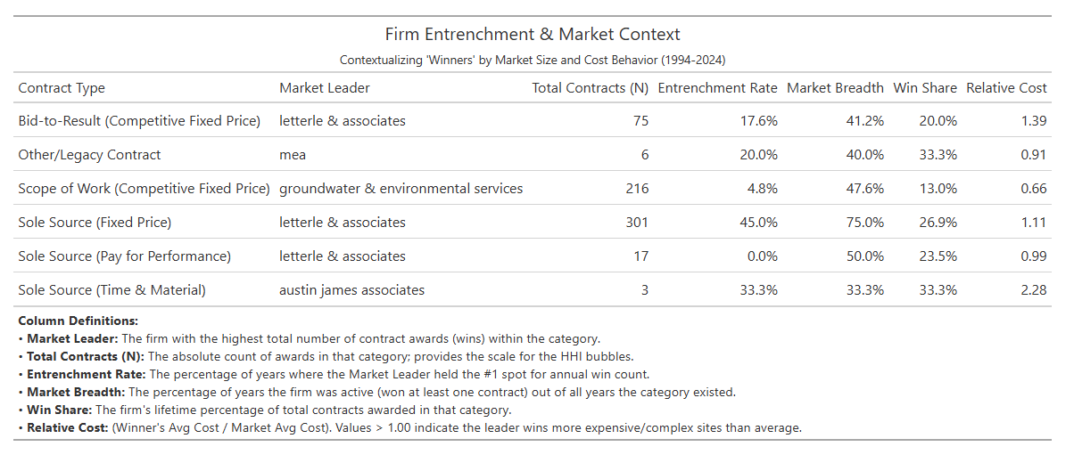
Notes:
1. The Metric Discrepancy: Lifetime vs. Annual Dominance
"This table presents a critical nuance in how we measure market power. You might notice a discrepancy: on the previous slide, we saw a 'Top Firm Win Share' of roughly 45.8%, but here, the 'Win Share' for the same category is only 20.0%.
This is not an error; it is a difference in perspective. The previous table measured Annual Intensity—how much the winner takes in a single year.
This table measures Lifetime Dominance. It answers the question: 'Over the last 30 years, how much of the total market did the single biggest player capture?'
To illustrate: If Firm A wins everything in 2010 and Firm B wins everything in 2011, the 'Annual' metric is 100% (total dominance per year), but the 'Lifetime' metric is only 50% (shared dominance over time). This tells us that while our market is highly concentrated in any given year, leadership does rotate somewhat over the decades."
2. The Market Leader
"Despite that rotation, one name stands out. Letterle & Associates is the dominant 'Global Leader' across three major categories: Bid-to-Result, Sole Source (Fixed Price), and Sole Source (Pay for Performance).
They are the recurring 'winner' in the dataset."
3. The Cost Ambiguity (Relative Cost)
"Crucially, we need to analyze the cost of their dominance. Letterle’s Relative Cost is 1.39 in the competitive 'Bid-to-Result' category.
This means their winning contracts are 39% more expensive than the market average.
This raises a classic economic question regarding dominant firms: Is this a premium for Complexity or a premium for Market Power?
Hypothesis A (Complexity): They are the most technically advanced firm, winning the high-liability 'mega-projects' that other firms cannot touch.
Hypothesis B (Market Power): They charge higher prices simply because they are the entrenched leader with limited competition.
The current data confirms the cost disparity but does not yet isolate the cause. Further analysis is required to determine if their specific sites are indeed hydrogeologically more complex than the average. Interestingly, for Sole Source (Pay for Performance) contracts, their cost ratio drops to 0.99, suggesting their pricing aligns with the market average when the contract structure changes."

Slide 30
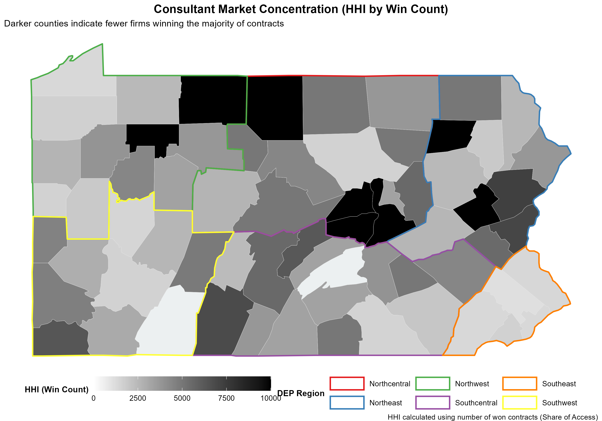
Notes:
This map visualizes the geographic distribution of competition.
Darker counties represent areas with higher HHI scores (fewer winning firms).
The variation demonstrates that competition is not uniform.
We see distinct 'competition deserts,' particularly in the Northcentral and Western regions, where the market is locked down by very few vendors.
This implies that the competition problem is partly a geographic availability issue.

Slide 31
Possible Extensions
Risk Scoring and Improved Interventions Rules

Slide 32
Finding an Improved recommendation rule
What we know right now:
Current analysis suggest adjusters’ push claims to auctions at 4-years.
Cost intervention is not clear at this point of the analysis
Can we do better?
If we know the value/return to competitive bidding:
  Cost savings: Does the bidding process save PA money?
  Time Savings: Does the bidding process expedited remediation process?
  Quality Improvements: Tough to measure? Does the auction induce higher quality work?
Then we can optimize the claim to bidding pipeline to potentially reduce costs and speed up remediation.
Current challenge: The data provided and the process as I understand it doesn’t allow us to answer those question at this time.
Notes:
Visual Orientation: "This slide summarizes where we stand in the analysis and identifies the 'Gap' we are trying to bridge."
The Takeaway: We have identified the current behavior, but we haven't yet proven what the 'optimal' behavior should be.
Talking Points:
The 4-Year Baseline: Our data confirms that the current 'Tacit Rule' for adjusters is to wait until Year 4 to escalate a claim to auction.
The Optimization Goal: We want to move from a reactive system (waiting for a claim to stall) to a proactive system (predicting a claim will stall).
The Three Pillars of Value: To justify an earlier auction, we need to prove it either saves money, saves time, or results in higher-quality remediation.
The Challenge: Current data doesn't yet allow us to see the 'Alternative Universe'—what would have happened if we auctioned a site in Year 1 versus Year 4

Slide 33
Finding an Improved recommendation rule
How does this work?
With known returns + a risk scoring algorithm
  We can think about different ways to target claims and calculate the cost/time/quality changes.
Next slides show the workflow
Notes:
1. The Early Warning System (Risk Score)
Think of the Risk Score as a "Day 1 Radar."
How it works: As soon as a new claim hits an adjuster's desk, the model scans the basic facts available at that exact moment—such as the age of the tank, the type of soil, the region, and the facility history.
What it does: It compares these initial facts against thousands of historical cases to answer one question: "Based on what we see right now, does this look like a claim that will spiral out of control?"
The Result: It assigns a simple 0% to 100% "severity rating."
Crucial Note: The model does not "cheat" by looking at what happens later (like construction delays or legal fights). It only uses the snapshot of information available on the very first day the claim is reported.
2. Calculating the Potential Savings (Value of Information)
To understand the business value, we combine the Radar (Prediction) with the Wasted Cost (Actual History).
Step 1: The Selection (Using the Radar) We simulate what would happen if we blindly trusted the "Day 1 Radar." We take the top 20% of claims that the model flagged as "High Risk" immediately upon arrival.
Step 2: The Valuation (Counting the Waste) For those specific flagged claims, we look at what actually happened in the real world. We calculate the "Sunk Cost"—the money spent on years of "wait-and-see" maintenance before the decision was finally made to auction the site.
Step 3: The Bottom Line The "Value of Information" is simply the sum of that "wait-and-see" money. It tells us: "If we had trusted the Day 1 Radar and moved these specific cases to auction immediately, this is the amount of money we would not have spent."

Slide 34
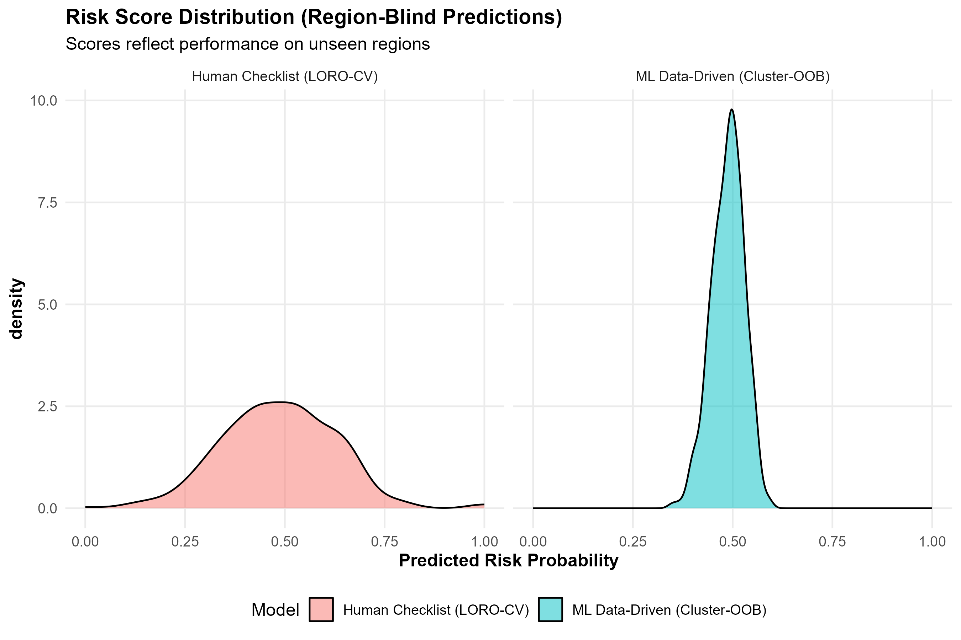
Notes:
Slide 33: Risk Score Distribution (The "Lens" Comparison)
Visual Orientation: "This density plot shows how two different 'lenses' view the same group of claims. The horizontal axis is the predicted risk level."
The Takeaway: Machine Learning (ML) gives us a much sharper, more confident way to identify risky claims before they become expensive.
Talking Points:
Human Checklist (Red/Left): Notice how the 'hill' is wide and flat. This means our current checklists see most claims as 'medium risk.' It’s hard to tell the difference between a routine site and a disaster.
ML Data-Driven (Blue/Right): Notice the sharp, tall peak. The algorithm is much more decisive. It can filter out the 'noise' and pinpoint exactly which claims have high-severity characteristics.
The Strategic Advantage: Using the Blue model at intake would allow us to prioritize high-risk sites for expert review on Day 1

Slide 35
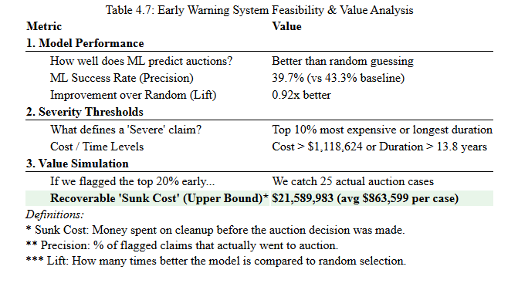
Notes:
1. Model Performance (How well does it work?) "The model acts as a triage filter, not a crystal ball. When the AI flags a claim as 'High Risk,' it effectively identifies a future auction case 40% of the time (25 actual auctions out of 63 flagged). While not perfect, this allows the team to focus expedited review resources on a smaller, higher-probability pool of claims rather than reviewing the entire portfolio at random."
2. Severity Thresholds (What counts as 'High Risk'?) "This analysis defines 'Severe' strictly as the worst-case outliers—specifically the top 10% of the portfolio. To trigger a high-severity flag, a claim must exceed $1.1 million in total cleanup costs or remain open for longer than 13.8 years. These are the 'bleeder' cases that disproportionately drain the fund."
3. Value of Information (What is the business case?) "The $21.6 million figure represents the 'Sunk Cost'—money spent on these 25 flagged claims before they were finally sent to auction. This is the theoretical upper limit of savings. If the Early Warning System had caught these cases at Day 1, and we had moved them to auction immediately, this is the maximum amount of 'wait-and-see' spending that could have been avoided."
The Headline Figure: If we used this model to flag the Top 20% of risky claims early, we would have targeted 25 actual auction cases and potentially recovered up to $21.5 Million in 'Sunk Costs' (money spent before the auction fix was applied).
Interpretation: While $21.5M is an upper bound, even capturing 25% of that through earlier auctions would represent a massive win for the Fund.

Slide 36
Whats needed to go further?
Two data questions and one bigger design questions
1) Is it possible to get claims adjusters assigned for all claims not just those in the contracts?
2) Is it feasible to get the claims cost flows? For example:
we see like the year-month spend for claim id [abc123]?
3) Improved Auction data? – currently we only know the winners to really study the returns to auctions we need more info of what happens during each auction: full bid lists, SOW milestones? etc
3) Feasibility of data-driven claim to auction policy experiment?
Notes:
Adjuster Tracking: We need to know which adjusters are assigned to every claim. This plus the guiding rules on when a claim triggers auction consideration allows for more advanced
policy-evaluation techniques that let us estimate the returns to competitive bidding processes.
Cash Flow Data: Instead of just seeing the 'Total Bill' at the end, we need to see the month-by-month spending. This helps us see exactly when a project 'stalls' and costs start spiraling.
Auction Transparency: We need the full bid lists, not just the winner. This tells us if the market is truly competitive or if only one vendor is bidding on certain types of work.
To a big degree the bids and who the bidders are is where the power of auction data lies. Deep market understanding exists in those data.

